Slide 1
videogames sales
File created on: 3/29/2022 6:34:18 PM

Slide 2
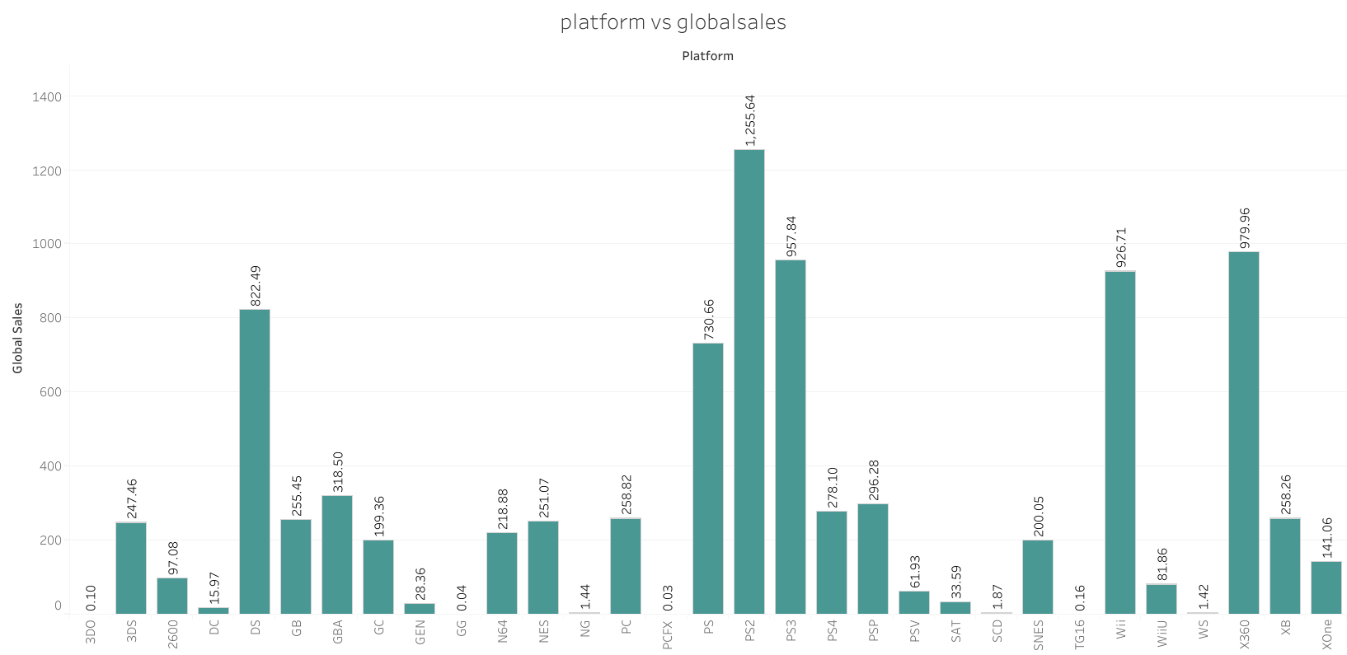

Slide 3
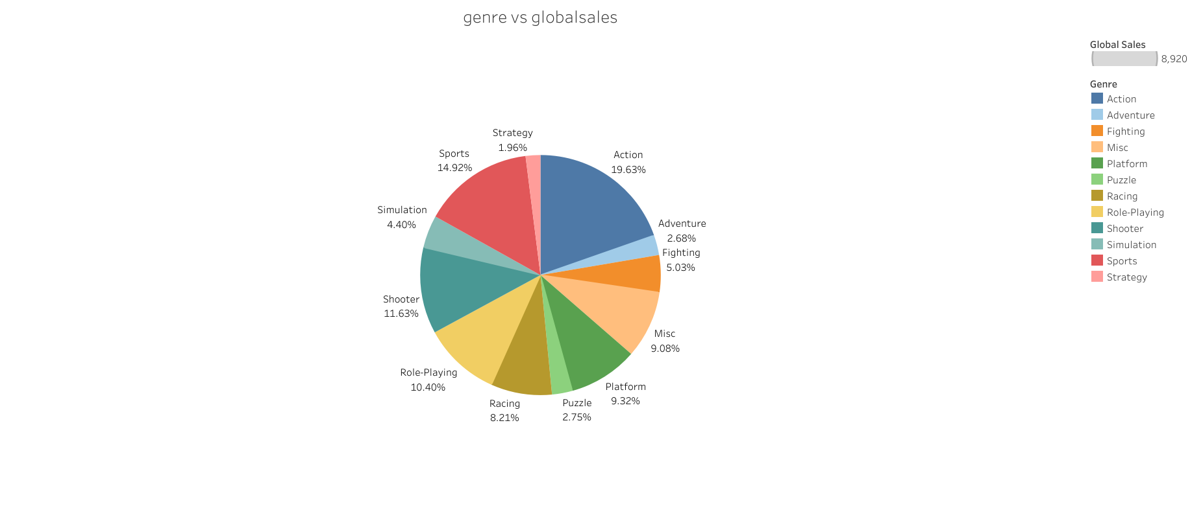

Slide 4
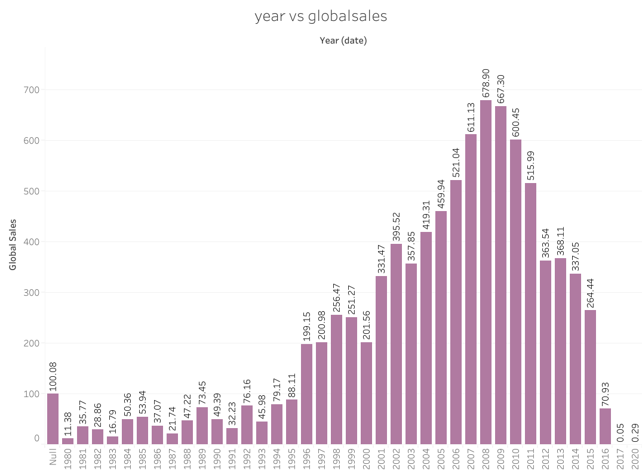

Slide 5
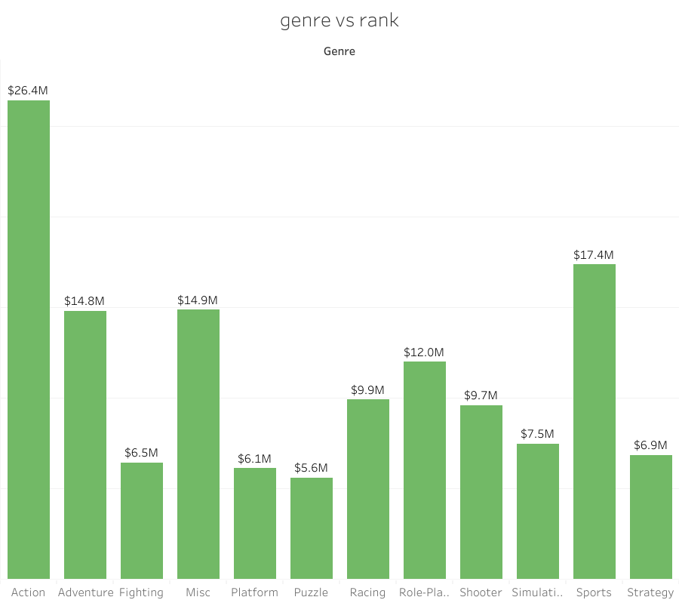

Slide 6
